Slide 1
Analysis of Cryptocurrency Time Series Data
INFO 550
Christian Enriquez

Slide 2

Background
A cryptocurrency is a digital asset designed to work as a medium of exchange.
Uses cryptography to secure its transactions/creation of additional units, and to verify the transfer of assets.
Cryptocurrencies use decentralized control as opposed to centralized electronic money and central banking systems.
https://altcointrading.io/theme/img/altcoin.jpg

Slide 3
What gives cryptocurrencies value?
Scarcity
Capped at 21 million (Bitcoin)
Utility
Advantage of e-commerce, free from regulation
Supply and Demand
Growing popularity

Slide 4
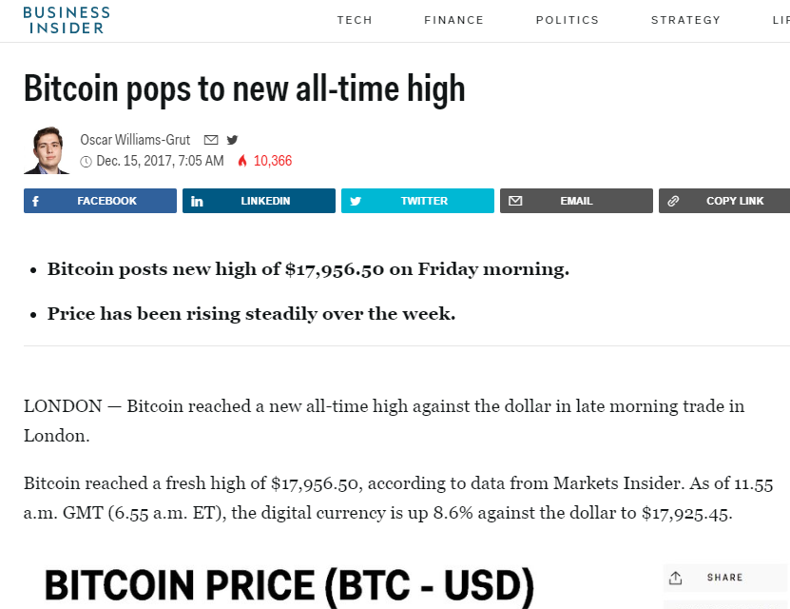
Purpose
The genesis of this project was an interest in the volatility of the cryptocurrency market.
As well as media’s influence…
In one sentence: What kind of trends exist in cryptocurrency prices?
http://www.businessinsider.com/bitcoin-prices-new-high-december-15-2017-12

Slide 5

First Steps
The majority of my data concerning cryptocurrency prices comes from the “cryptoR” package.
Retrieves all the open, high, low, close values for all cryptocurrencies. This retrieves data from CoinMarketCap's historical prices, exchange details and current prices API.

Slide 6
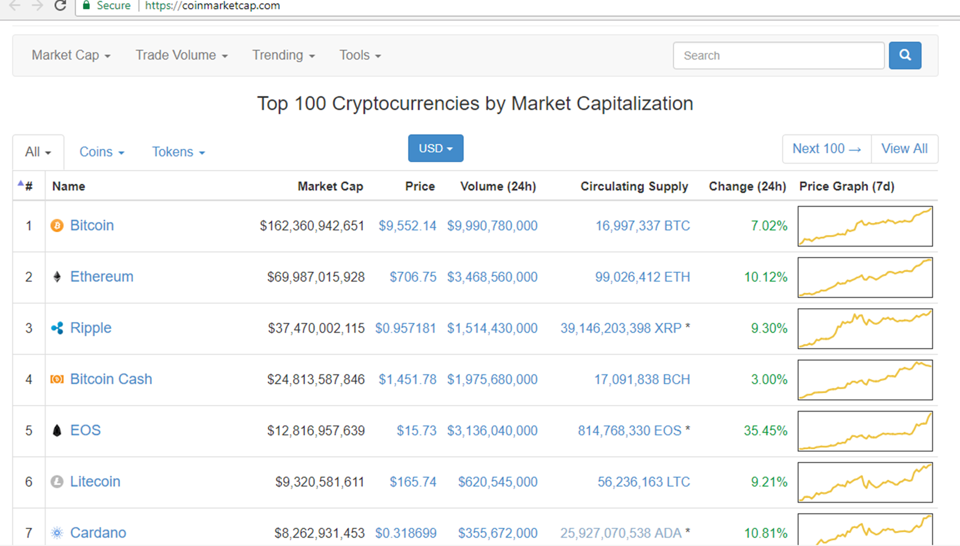

Slide 7
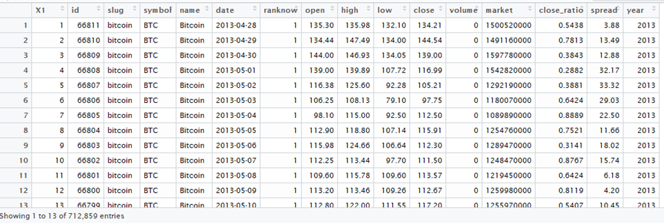
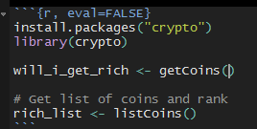

Slide 8
Disclaimer
Cryptocurrency prices are not decided by one central authority, but are set by the exchange where trading is taking place.
Indexes, are aggregates of different exchanges and are what are often cited by news media.
Coinmarketcap is an index

Slide 9
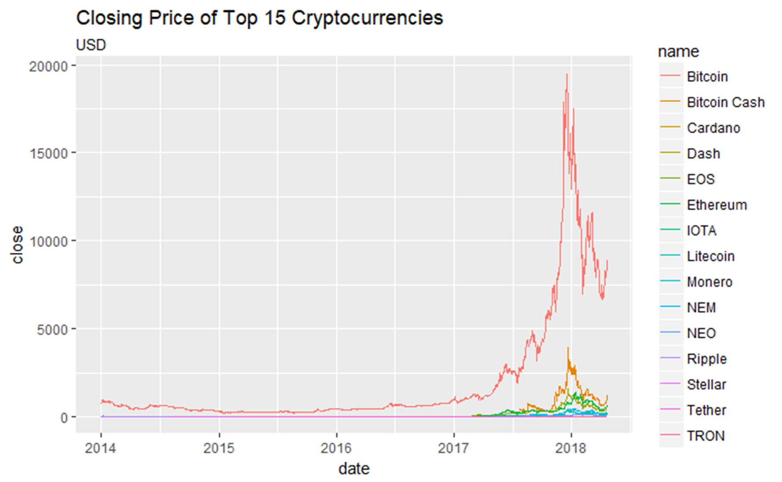

Slide 10
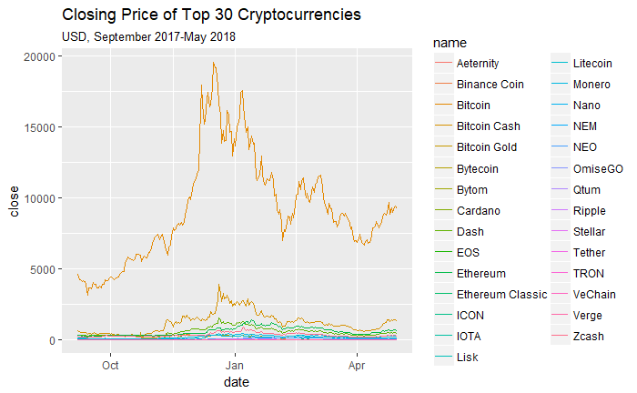

Slide 11
Midterm
Hypothesis One: Are the local peaks of these top cryptocurrencies similar in any way?
Hypothesis Two: are mentions of bitcoin in news media on twitter and price of bitcoin related?
Hypothesis Three: are mentions of bitcoin by the public related to market value of bitcoin?
Hypothesis Four: Is there a time of year that bitcoin value is generally high?
Hypothesis Five: Is there a relationship between number of bitcoin transactions and its market value?

Slide 12
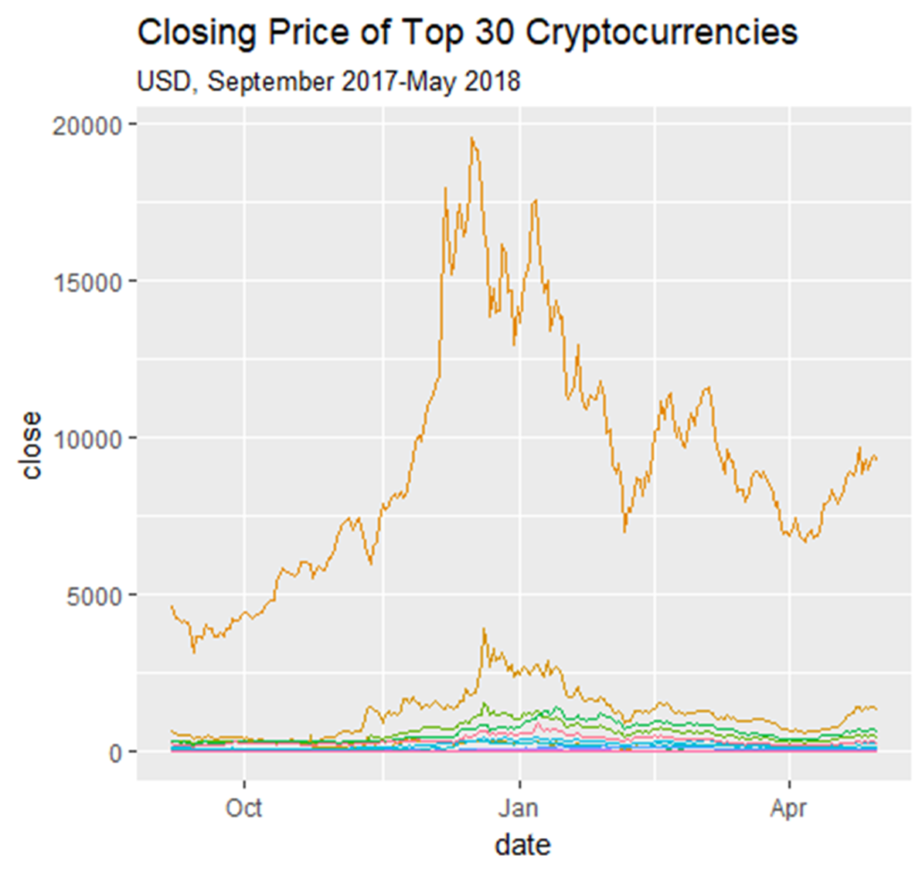
Hypothesis One: Are the local peaks of these top cryptocurrencies similar in any way?

Slide 13
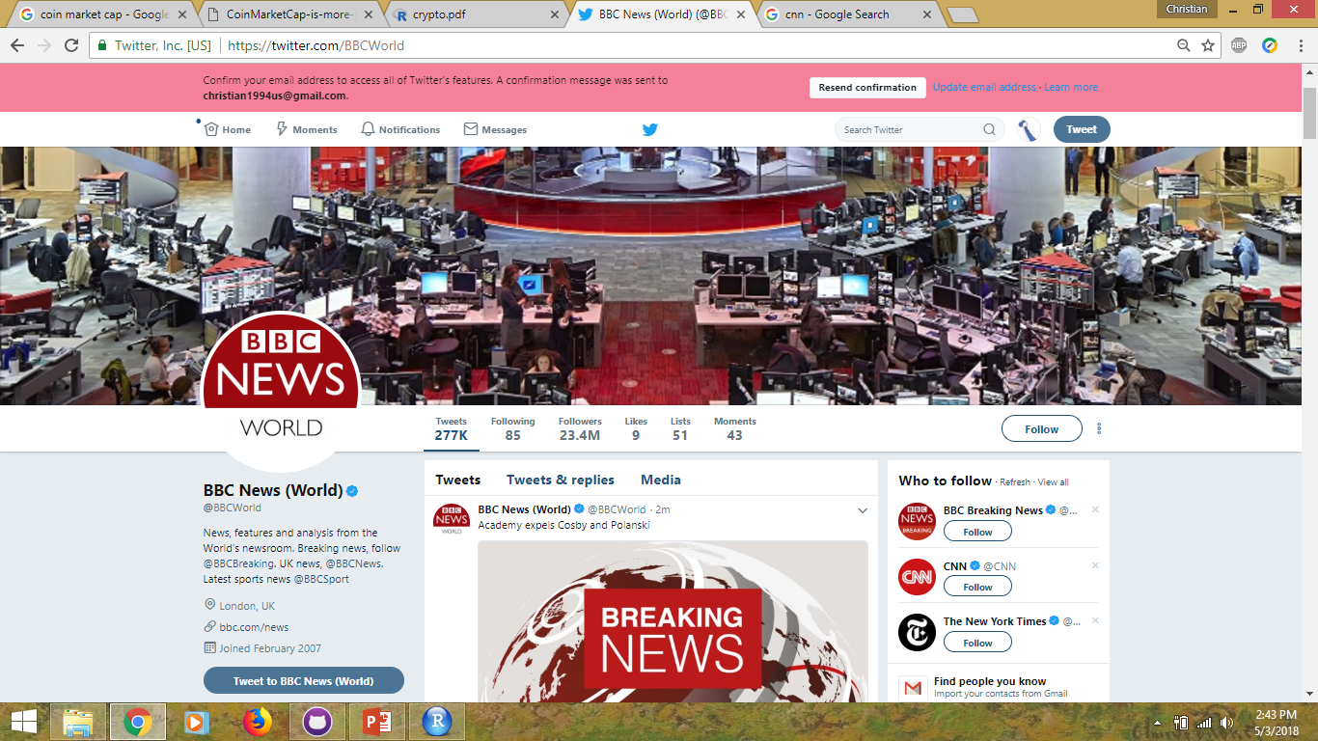
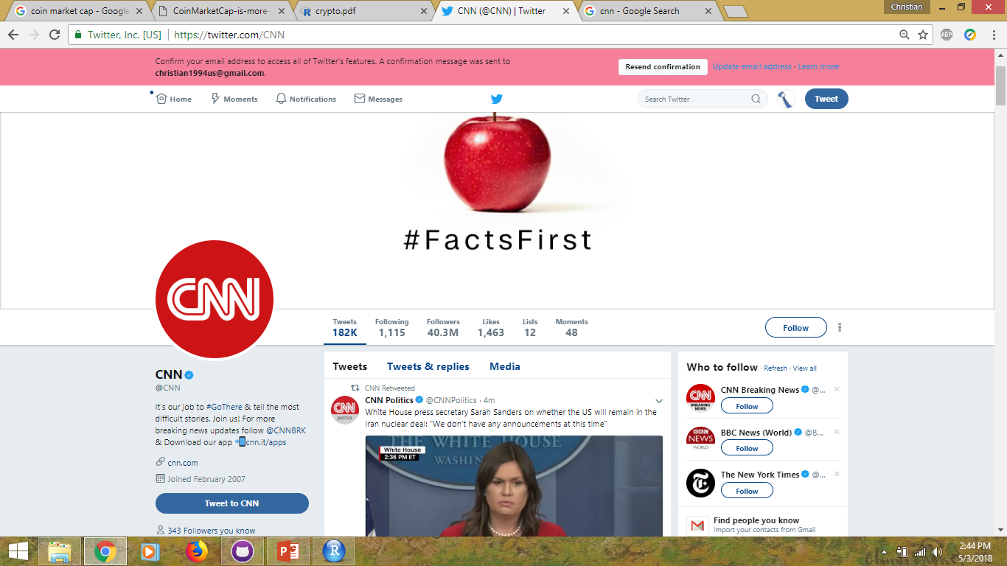
Hypothesis Two: Are mentions of bitcoin in news media on twitter and price of bitcoin related?

Slide 14

Hypothesis Three: are mentions of bitcoin by the public related to market value of bitcoin?
Public sees things before news reports.

Slide 15
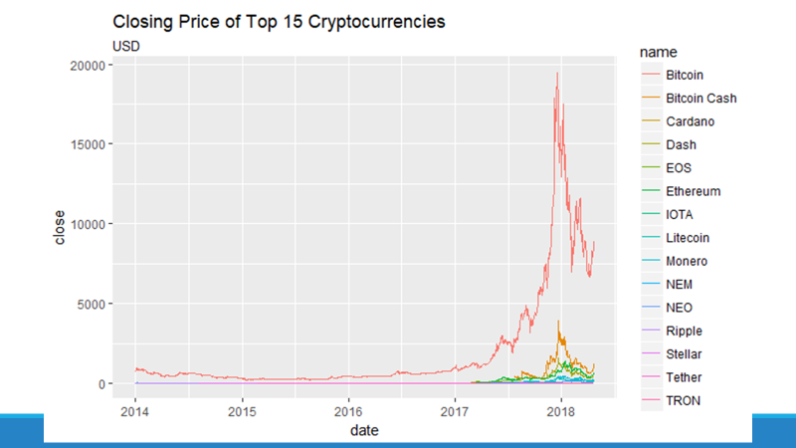
Hypothesis Four: Is there a time of year that Bitcoin value is generally high?

Slide 16
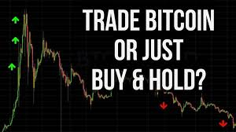

Hypothesis Five: Is there a relationship between number of bitcoin transactions and its market value?

Slide 17

rTweet Package

Slide 18
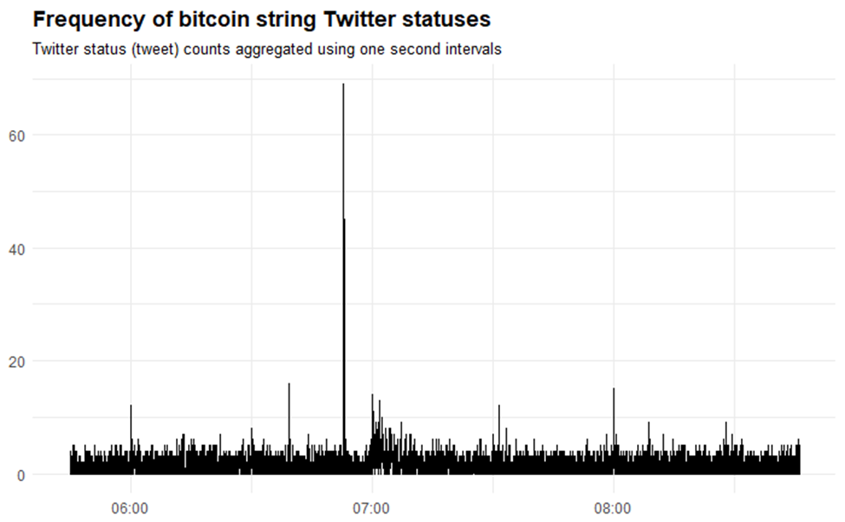
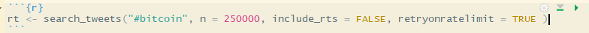

Slide 19
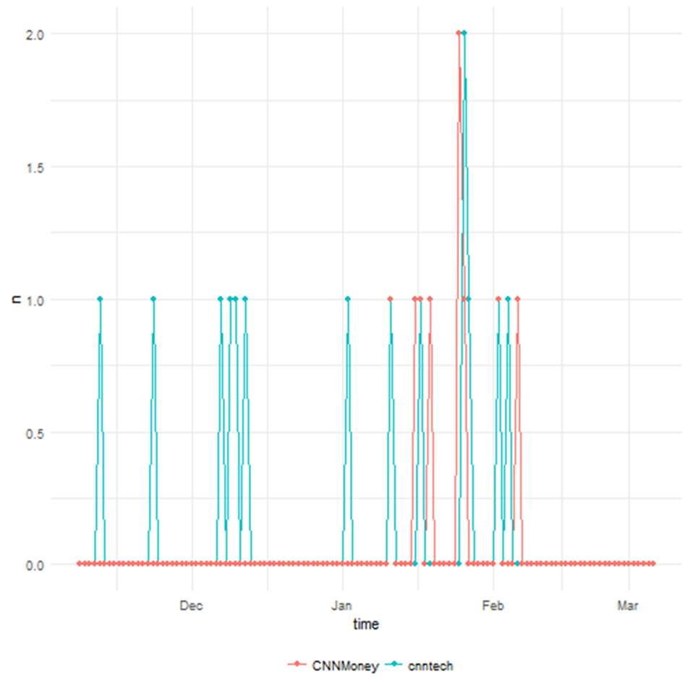
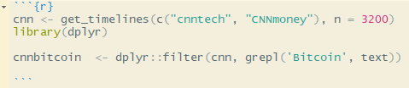

Slide 20
Expand my Hypotheses….
HYPOTHESIS TWO: ARE MENTIONS OF BITCOIN IN NEWS MEDIA ON TWITTER AND PRICE OF BITCOIN RELATED?
HYPOTHESIS TWO: ARE MENTIONS OF BITCOIN IN NEWS MEDIA AND PRICE OF BITCOIN RELATED?

Slide 21
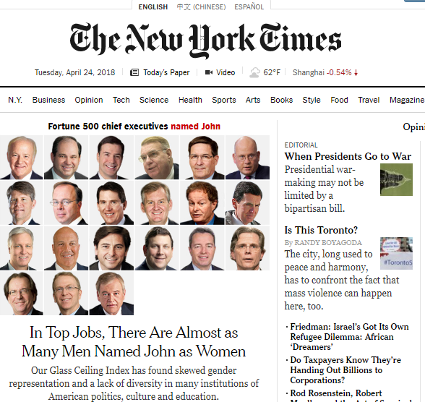
Rtimes
Interface to Congress, Campaign Finance, Article Search, and Geographic 'APIs' from the New York Times

Slide 22
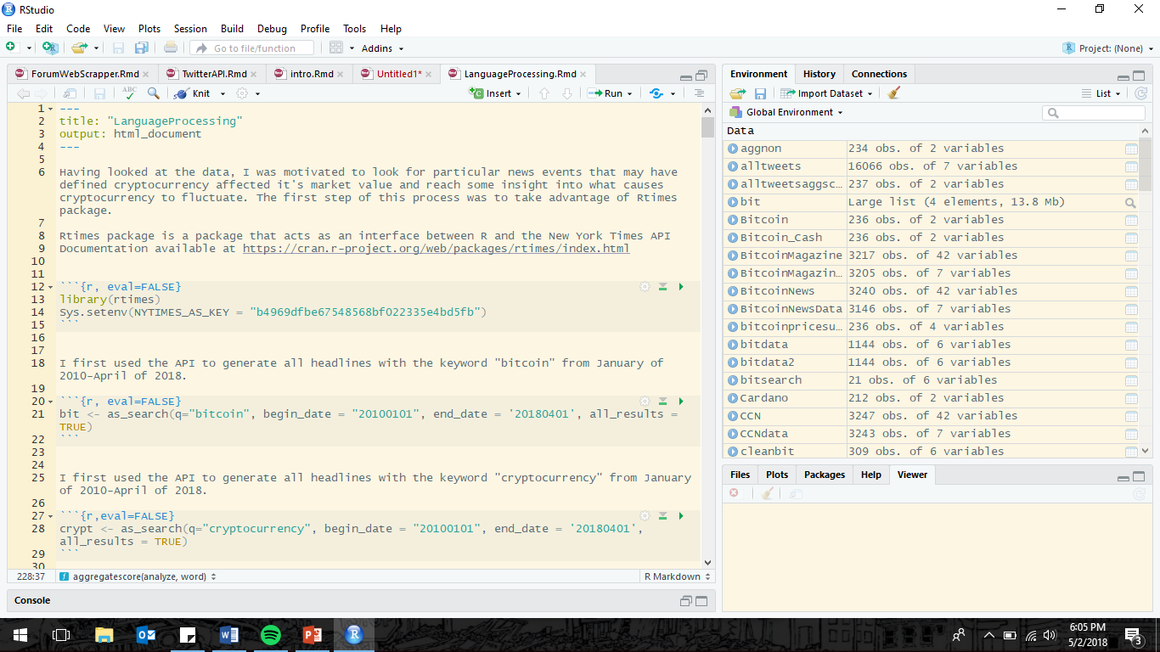
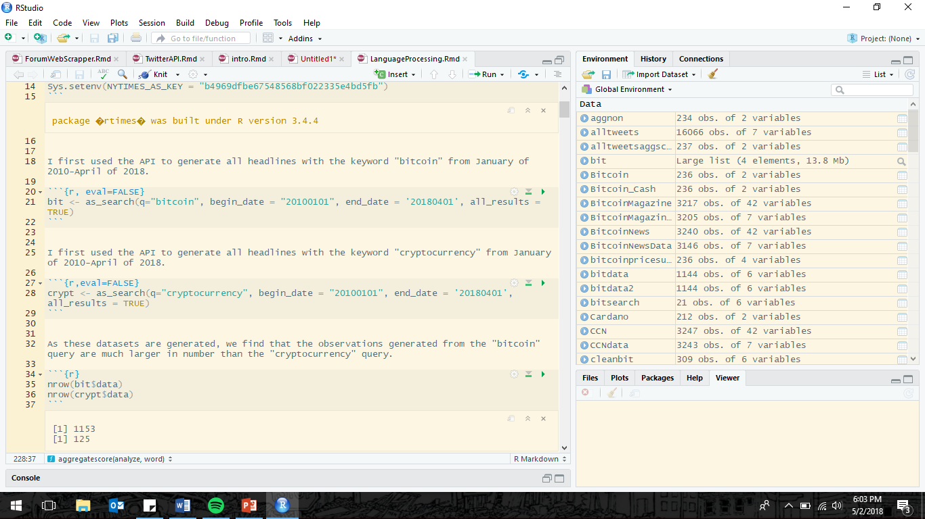

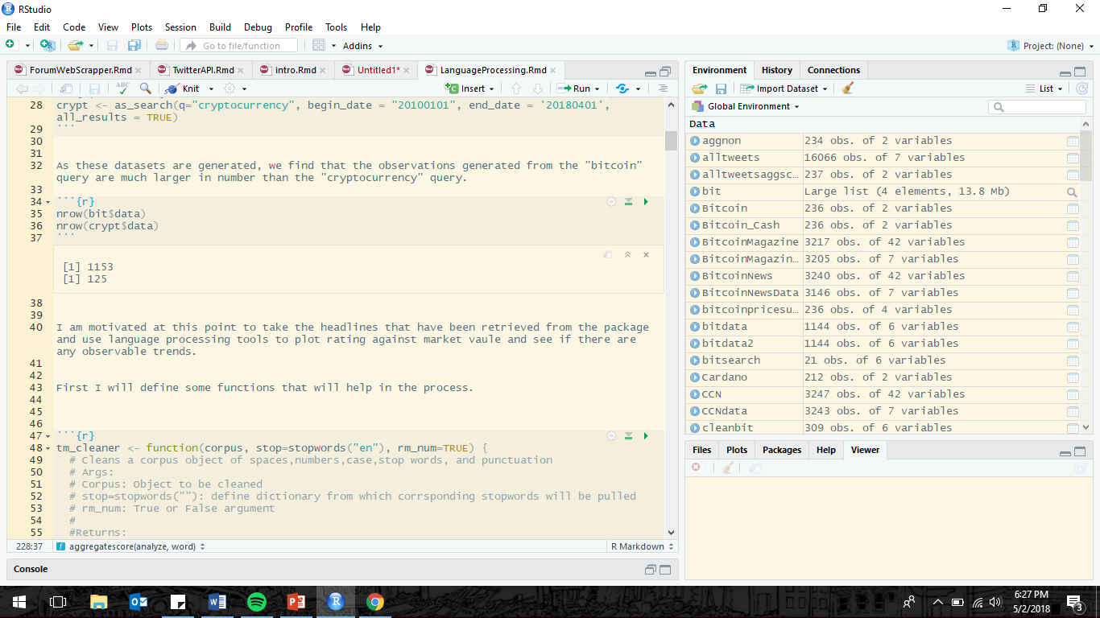

Slide 23
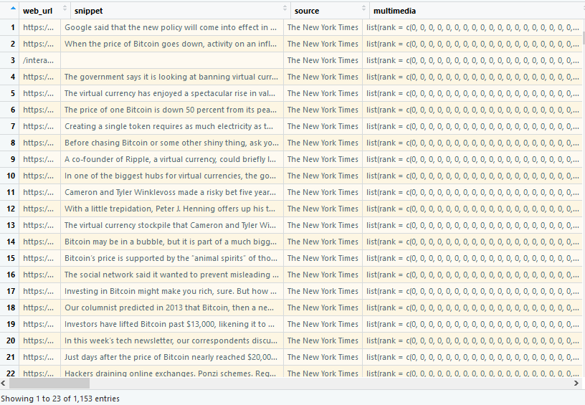
Each query returns a dataframe of 27 variables.
The ones of interest to me are
Headline.main – Headline of Article
Pub_Date-Date of publication

Slide 24
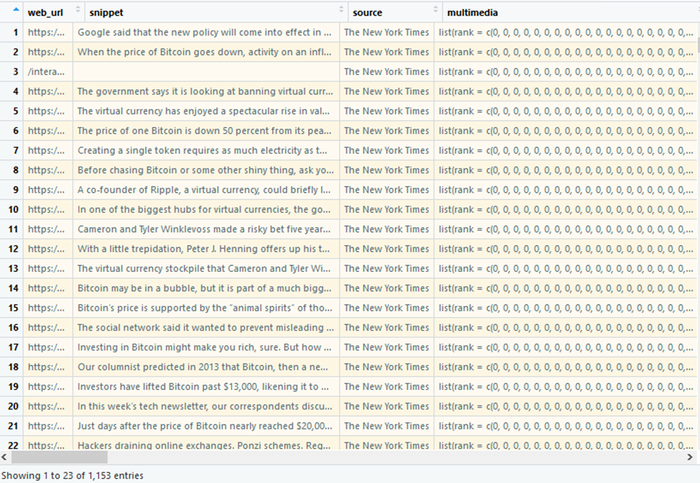
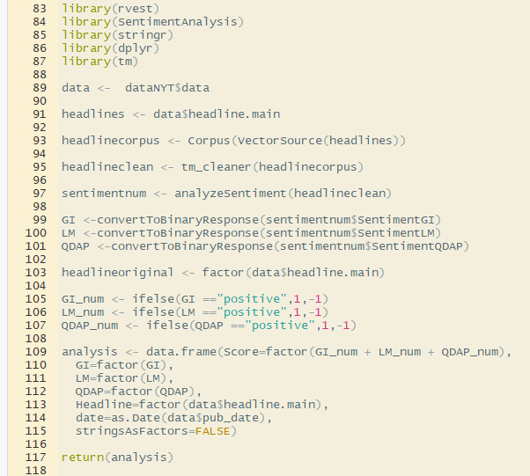
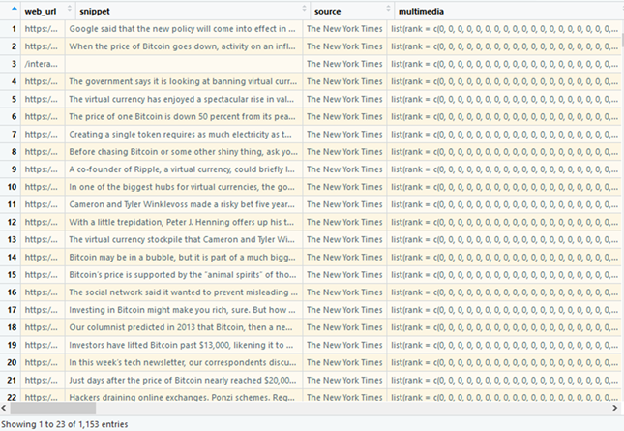
1143 Observations “Bitcoin”
125 Observations “Cryptocurrency ”

Slide 25
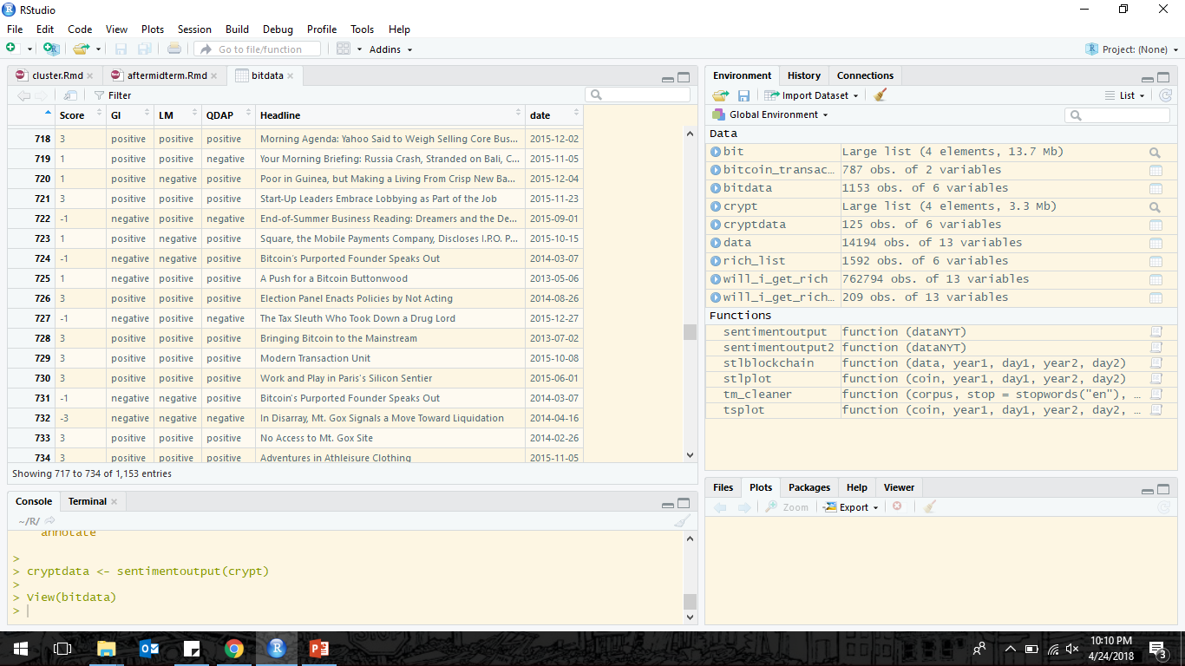
Looking at the data, there are a number of headlines that don’t seem to have much to do with bitcoin or crypto currency. will delete rows if no string of bitcoin and cryptocurrency exist

Slide 26

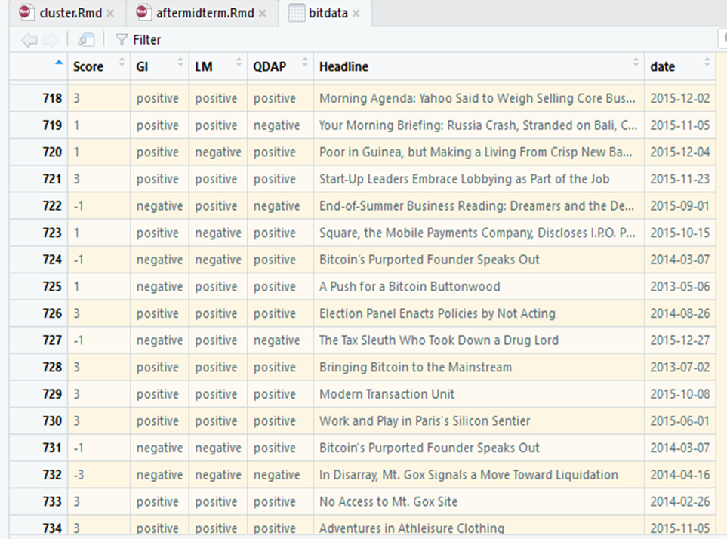
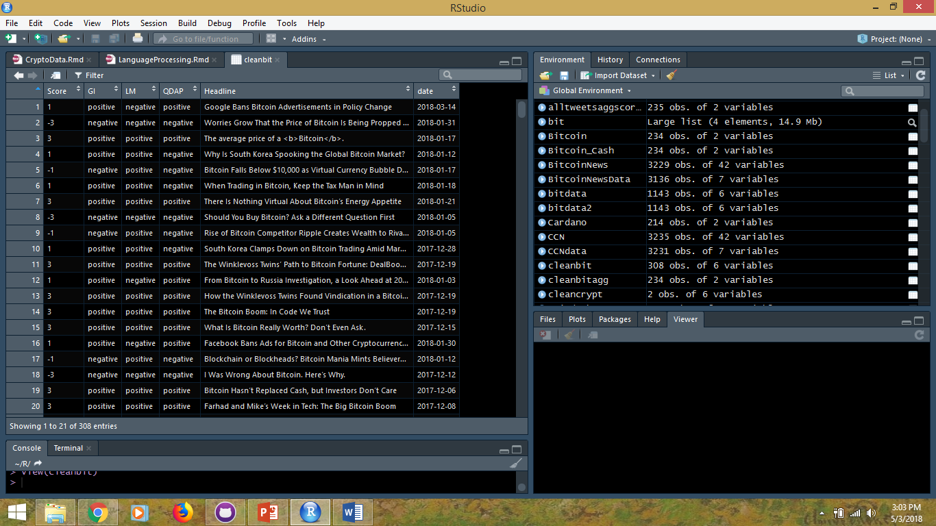
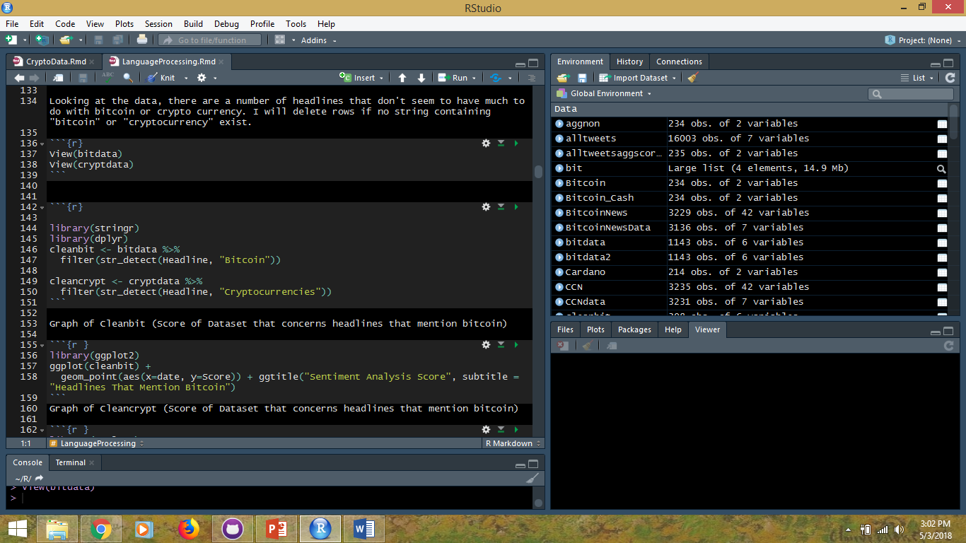
308 Observations “Bitcoin”

Slide 27
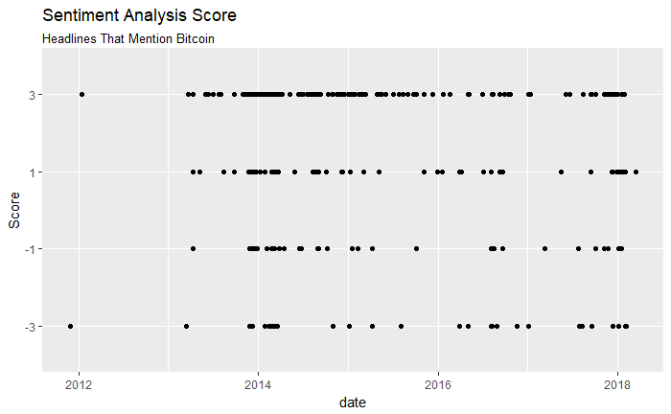

Slide 28
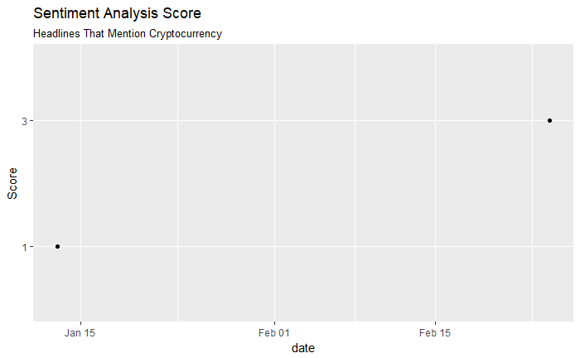

Slide 29
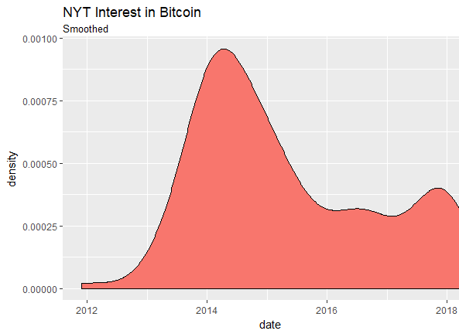
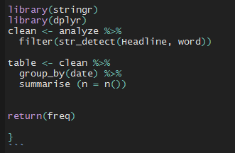

Slide 30
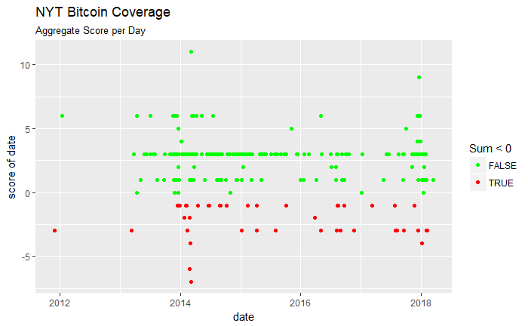
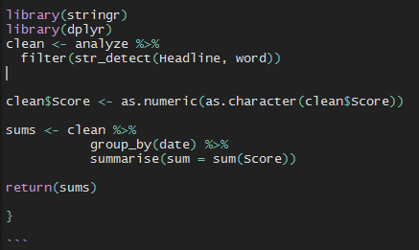

Slide 31

Problem of Bias….
What about more neutral responses?

Slide 32
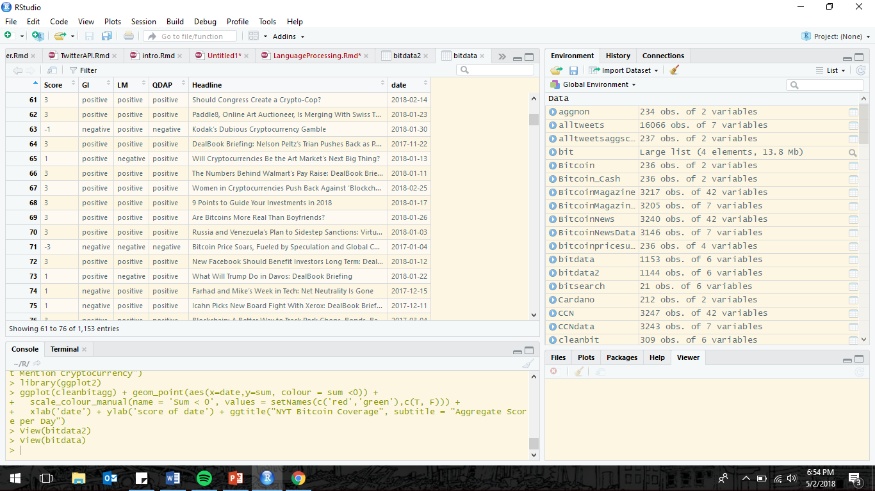
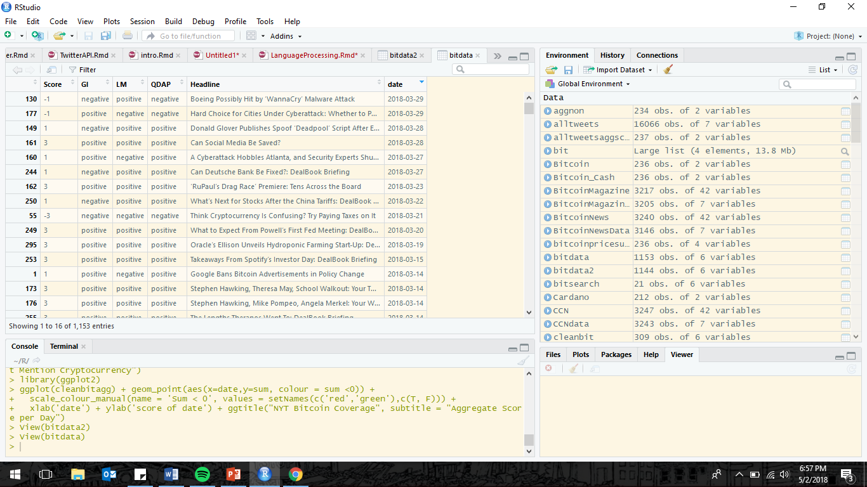
Problem of Bias….

Slide 33
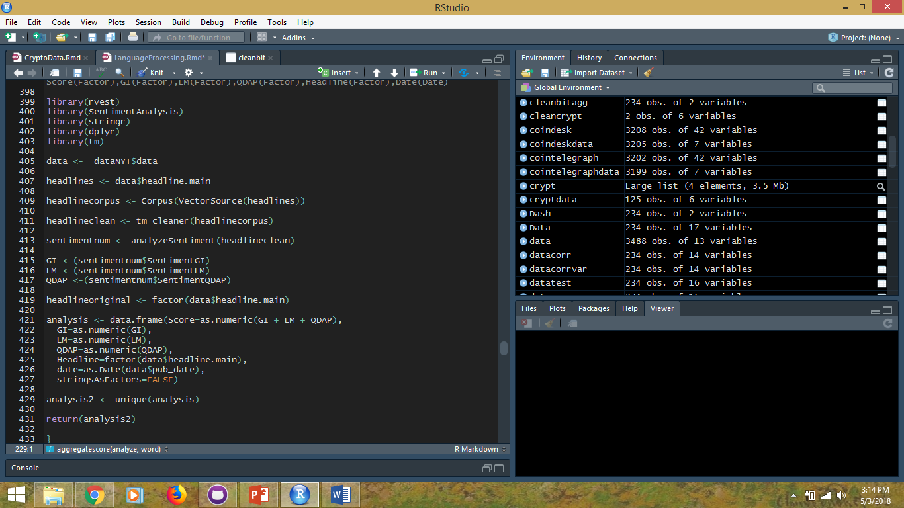
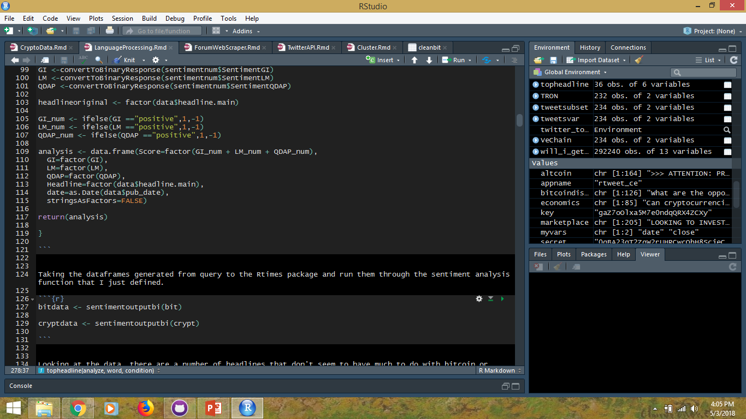
1143 Observations “Bitcoin”
125 Observations “Cryptocurrency ”

Slide 34
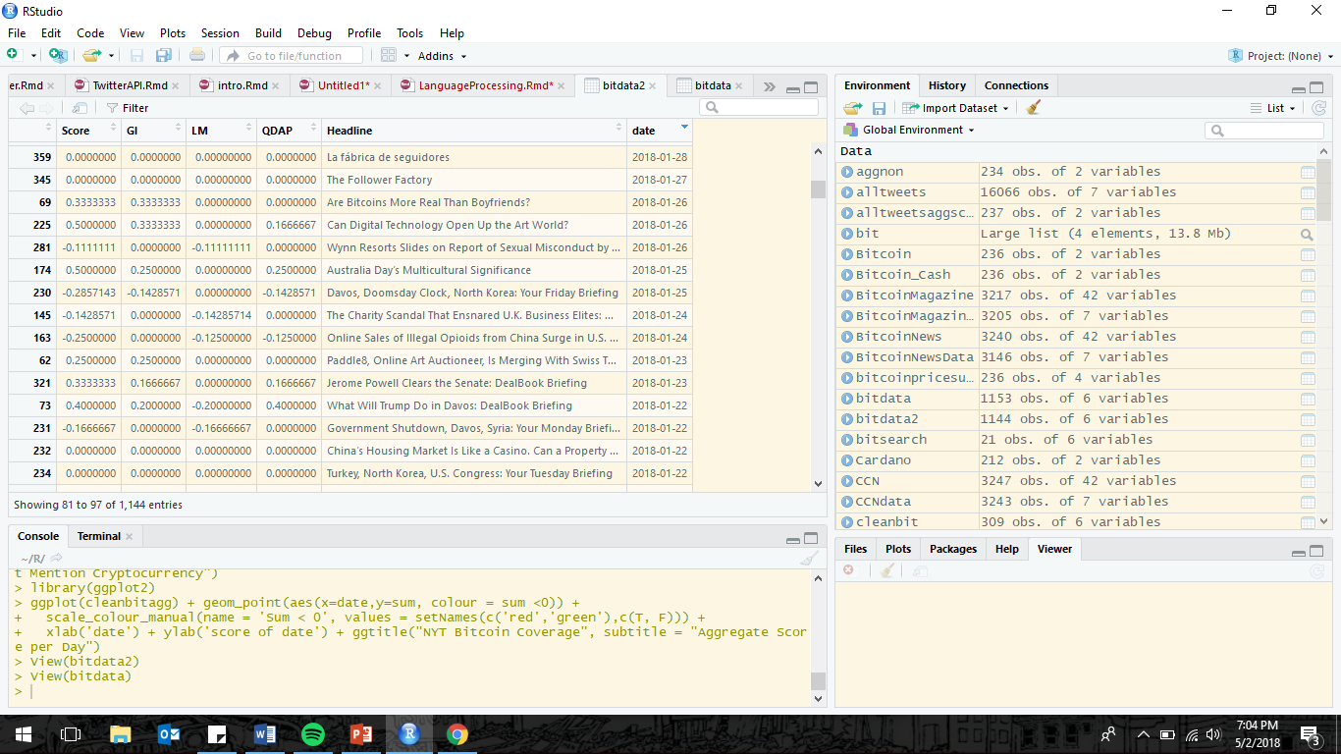
Problem of Bias….

Slide 35
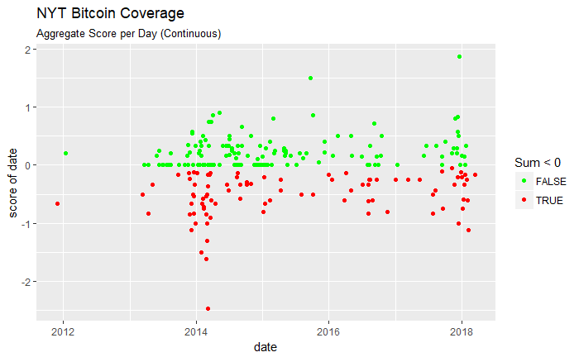
Notes:
Nonbinary score, line 520 USE MAYBE SOME EDIT

Slide 37
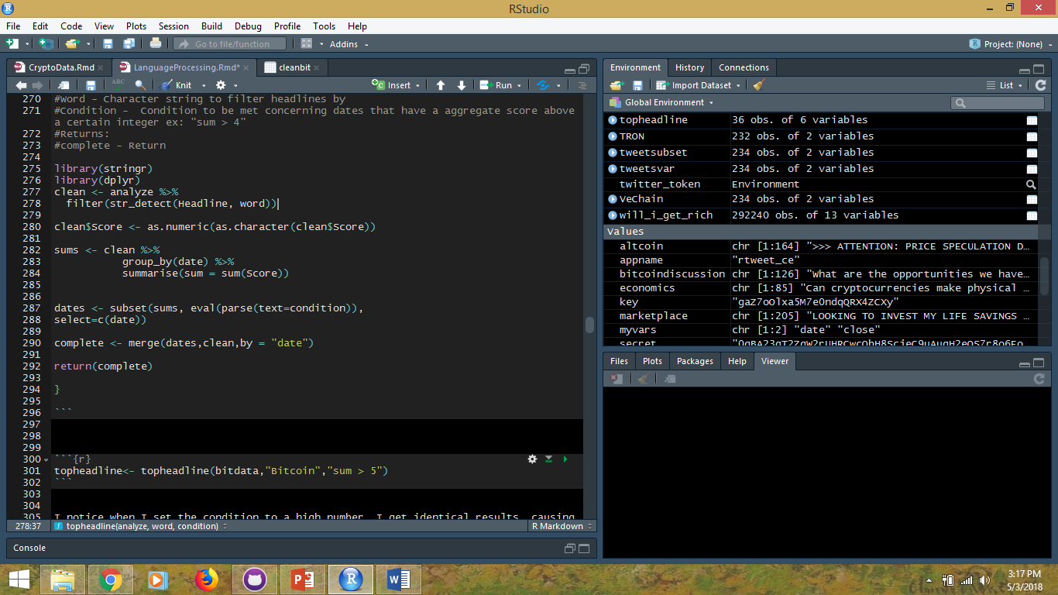
Headline Retriever
Notes:
Nonbinary score, line 520 USE MAYBE SOME EDIT

Slide 38
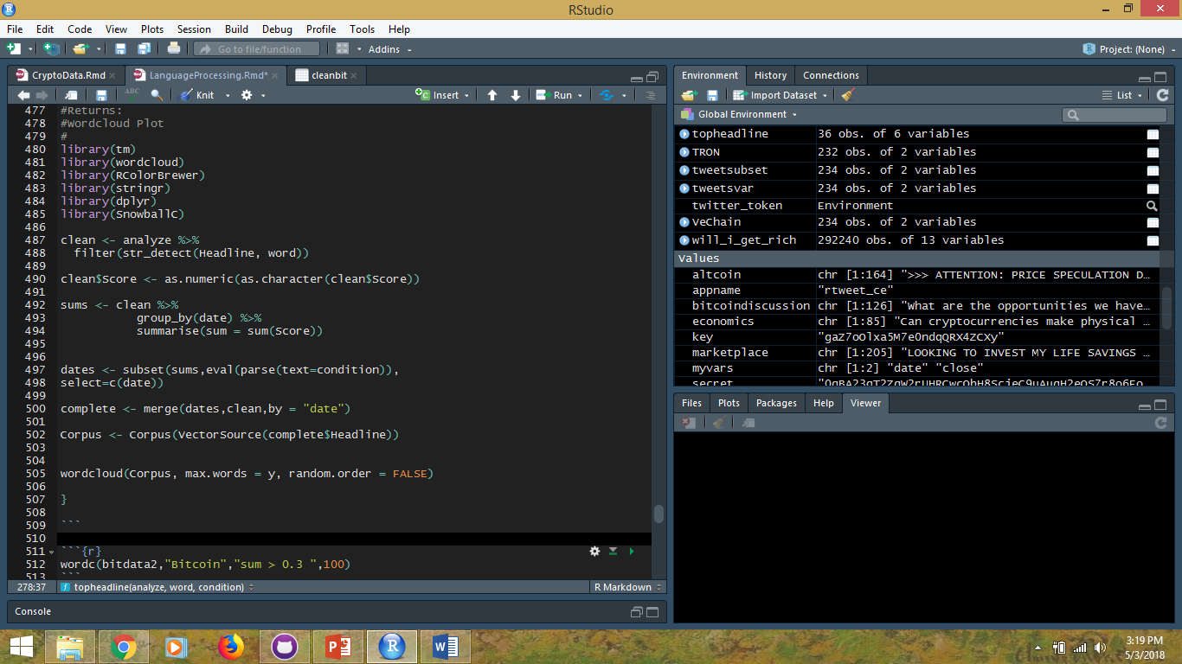
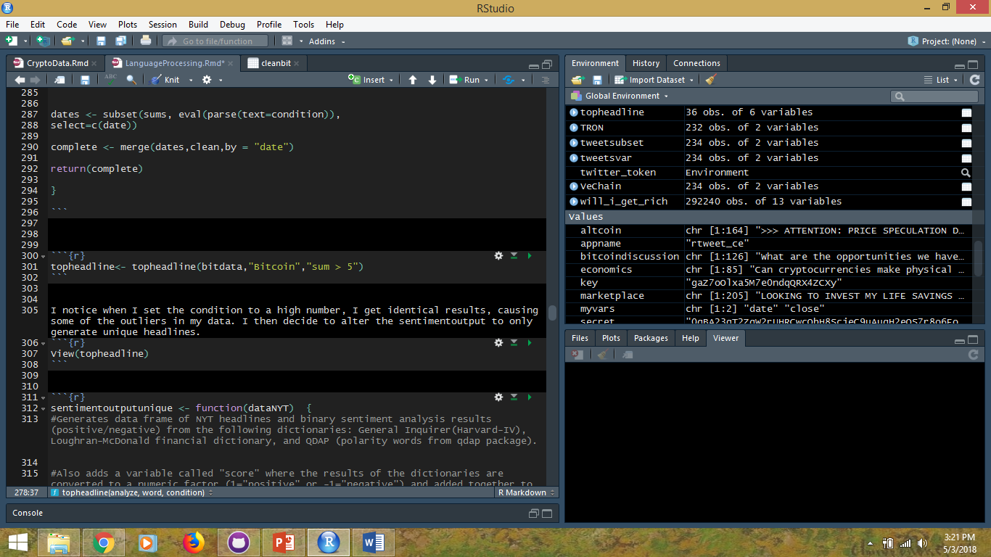
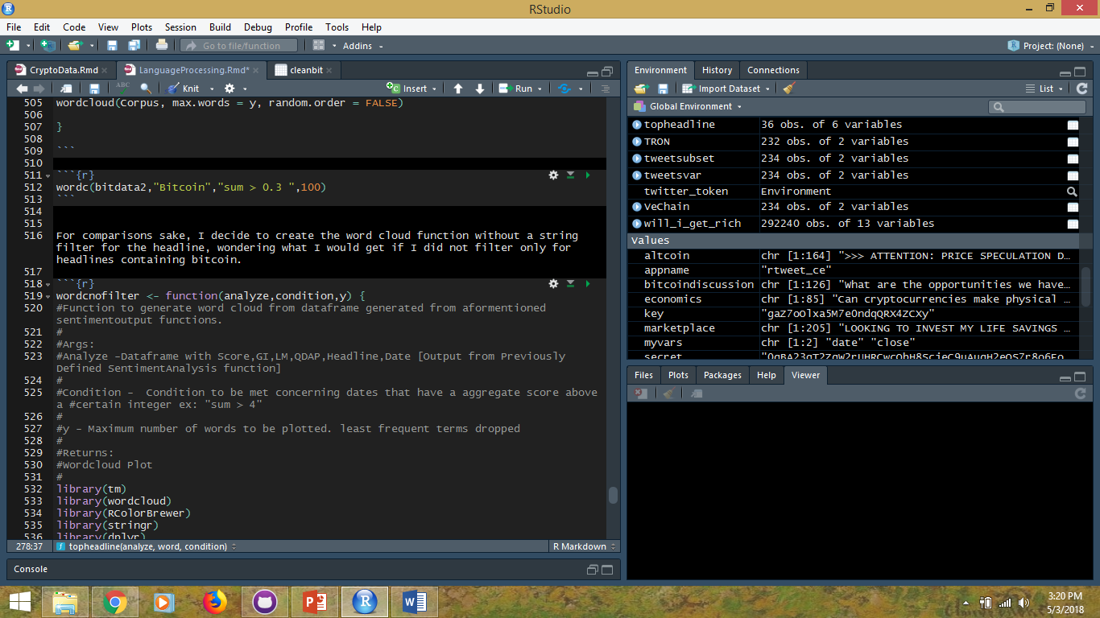
Headline Retriever
Notes:
Nonbinary score, line 520 USE MAYBE SOME EDIT

Slide 39
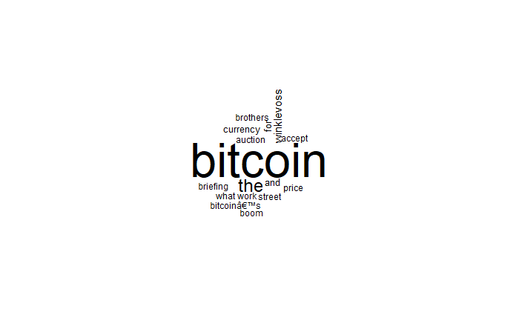
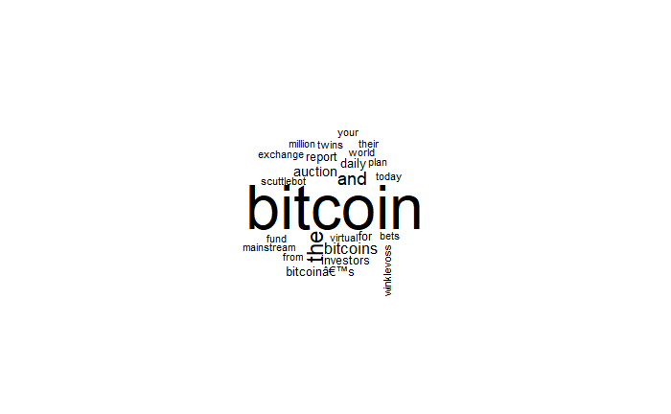
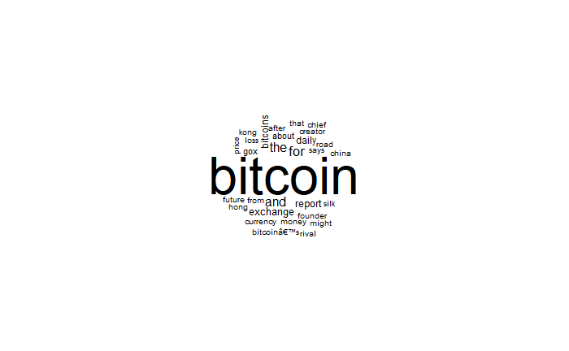
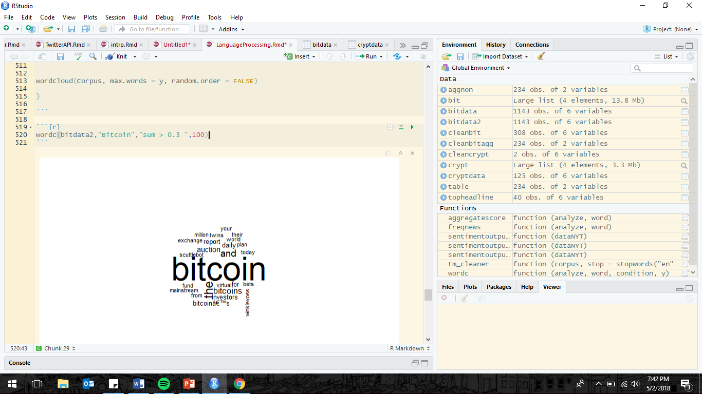
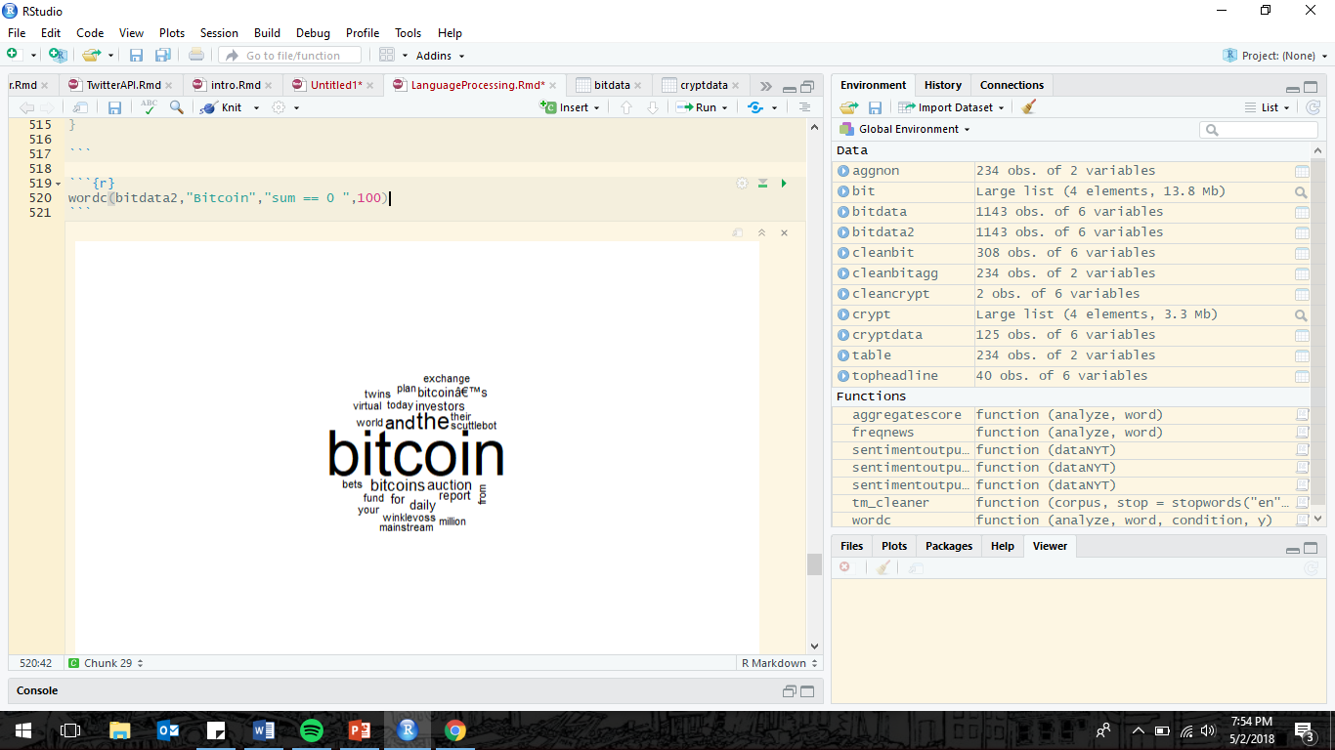
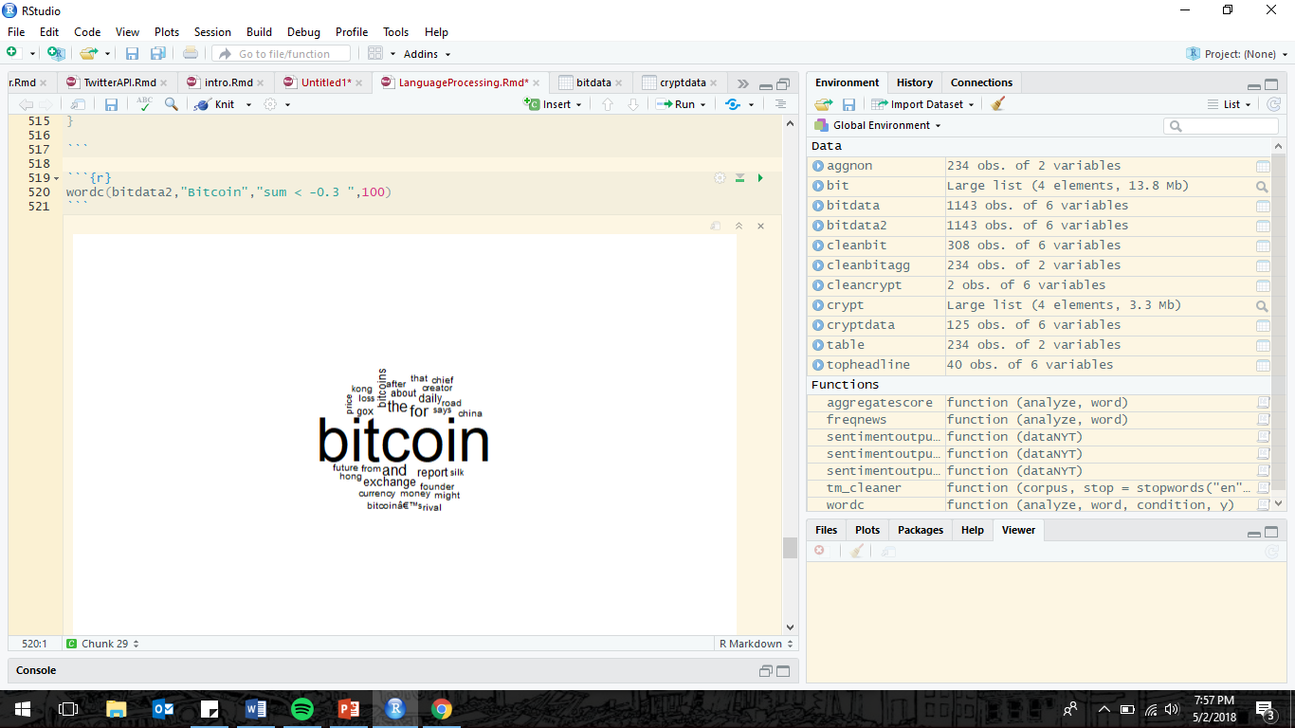

Slide 40

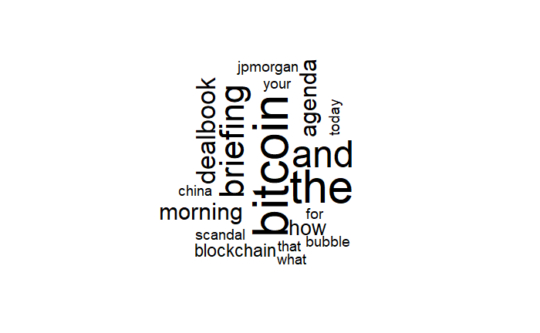




Slide 41



Slide 42
Hypothesis Three: Are mentions of bitcoin by the public related to market value of bitcoin?
What particular events have impacted bitcoin, is a certain type of event on the minds of those who follow bitcoin?

Slide 43


Slide 44


Slide 45




Slide 46



Slide 47



Bitcoindiscussion
Marketplace
Economics

Slide 48


Speculation
Altcoin

Slide 49





Fraud/Scams
Seeking Financial Advice
Banking organizations response to Cryptocurrencies

Slide 50
Decide to revisit Rtweets…
Given the large diversity of news that people on bitcoin forums discuss, I decide to change my approach.
I had been looking to pinpoint influential events that affected bitcoin, hence the focus on CNN/NYT.
However I decided to use sentiment analysis on news sources that covered cryptocurrencies exclusively.
Changing approach from significant events to a more “datyto day” approach

Slide 51





Cryptocurrency news sites
Coindesk.com
Cointelegraph.com
The Merkle
CCN (CryptoCurrency News)
Bitcoin News

Slide 52







Slide 53



Is news coverage of cryptocurrencies and the price of the top 15 cryptocurrencies related?
2017-09-07 to 2018-04-30

Slide 54


Slide 55


Slide 56


Slide 57


Slide 58


Slide 59


Hypothesis One: Are the local peaks of these top cryptocurrencies similar in any way?

Slide 60



Slide 61




Slide 62

From 2017-09-07 to 2018-04-30, the top (15) cryptocurrencies are significantly positively correlated.

Slide 63
Is news coverage of cryptocurrencies and the price of the top 15 cryptocurrencies related?
For some cryptocurrencies, sentiment analysis scores of news coverage is positively correlated. From 2017-09-07 to 2018-04-30

Slide 64


Notes:
stlplot("Bitcoin",2014,1,2018,112) – bitcoin vaule

Slide 65

The seasonality pattern appears to be a rally in the late months of each year, with a drop in the spring months.
Is there a time of year that bitcoin value is generally high?
Notes:
Seasonal component of bitcoin value

Slide 66




Slide 67
Hypothesis Three: are mentions of bitcoin by the public related to market value of bitcoin?
Public sees things before news reports.

Slide 68
Hypothesis Five: Is there a relationship between number of bitcoin transactions and its market value?

